Slide 1
ALY 6080 MOBIGROUND PROJECT
TRUNG PHAM
HONGMO JI
XINGKUN CHEN
CASEY HOFF

Slide 2
INTRODUCTION & GOALS
Mobiground spends approximately 1 million dollars yearly on campaigns.
Our goal is to use Exploratory Data Analysis (EDA), actionable dashboards, and models to help Mobiground understand their campaigns better.
We focused on the conversion rate by four main channels:
User segment and demographic
Campaign performance by budget and hour of day
Youtube Statistics
Cost Per Action by content and campaign performance Adwords

Slide 3
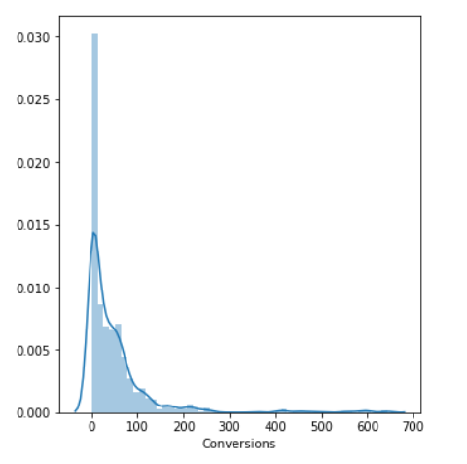
EDA

Slide 4
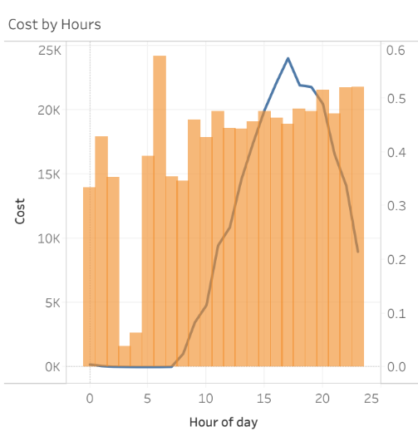
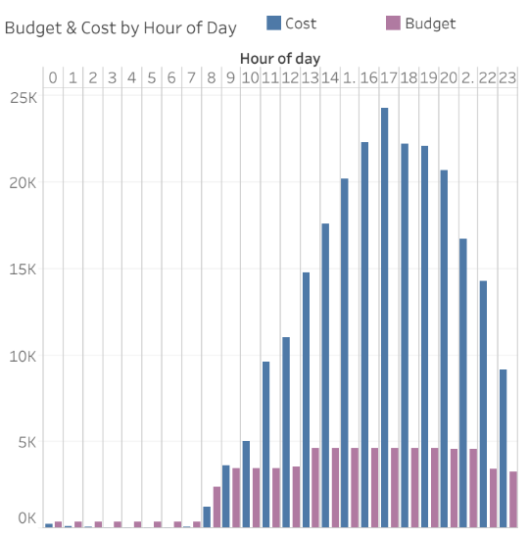

Slide 5
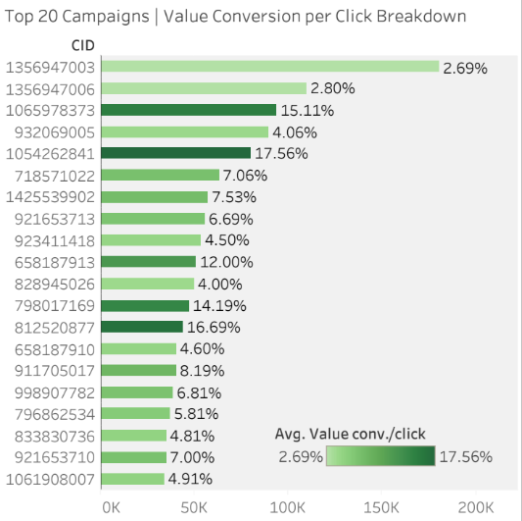

Slide 6
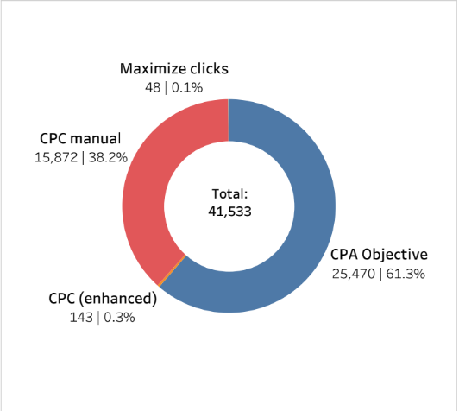
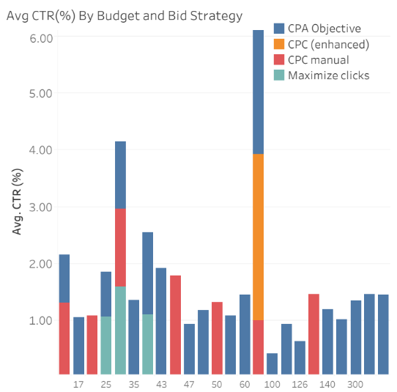

Slide 7
Data Cleaning
Python
Dealt with missing-values (strip dashes, treat all dashes as nulls)
Use only fully completed rows
One-hot encoding techniques to treat categorical varibles (will illustrate later)
Replace null non-viewable impressions distribution with 0
SQL
Join Campaign Performance by Hour with Campaign Performance by User to get Campaign ID and Name
Join Campaign name and Campaign ID to get which Content belongs to which Campaign
Create Channel column with the following ruleset:
case when Content like '%Google%' then 'Google Play’
when Content like '%iTunes% or Content like '%Apple%' then 'iTunes App Store’
when Content like '%youtube%' then 'Youtube’
else 'Other' end Channel
The result are 4 datasets fully cleaned and ready to be analyzed ☺

Slide 8

ACTIONABLE DASHBOARDS
Page 1: Campaign Performance

Slide 9

ACTIONABLE DASHBOARDS
Page 2: Channel Analysis

Slide 10
Customer Segmentation
We used unsupervised learning methods such as G-Means and K-Means method to cluster different customer into different groups: the resulting clusters identified were 63.
However, this is not easily interpretable for Mobiground as we want to group the users into buckets that Mobiground can better run promotions and ads on different customer segments

Slide 11
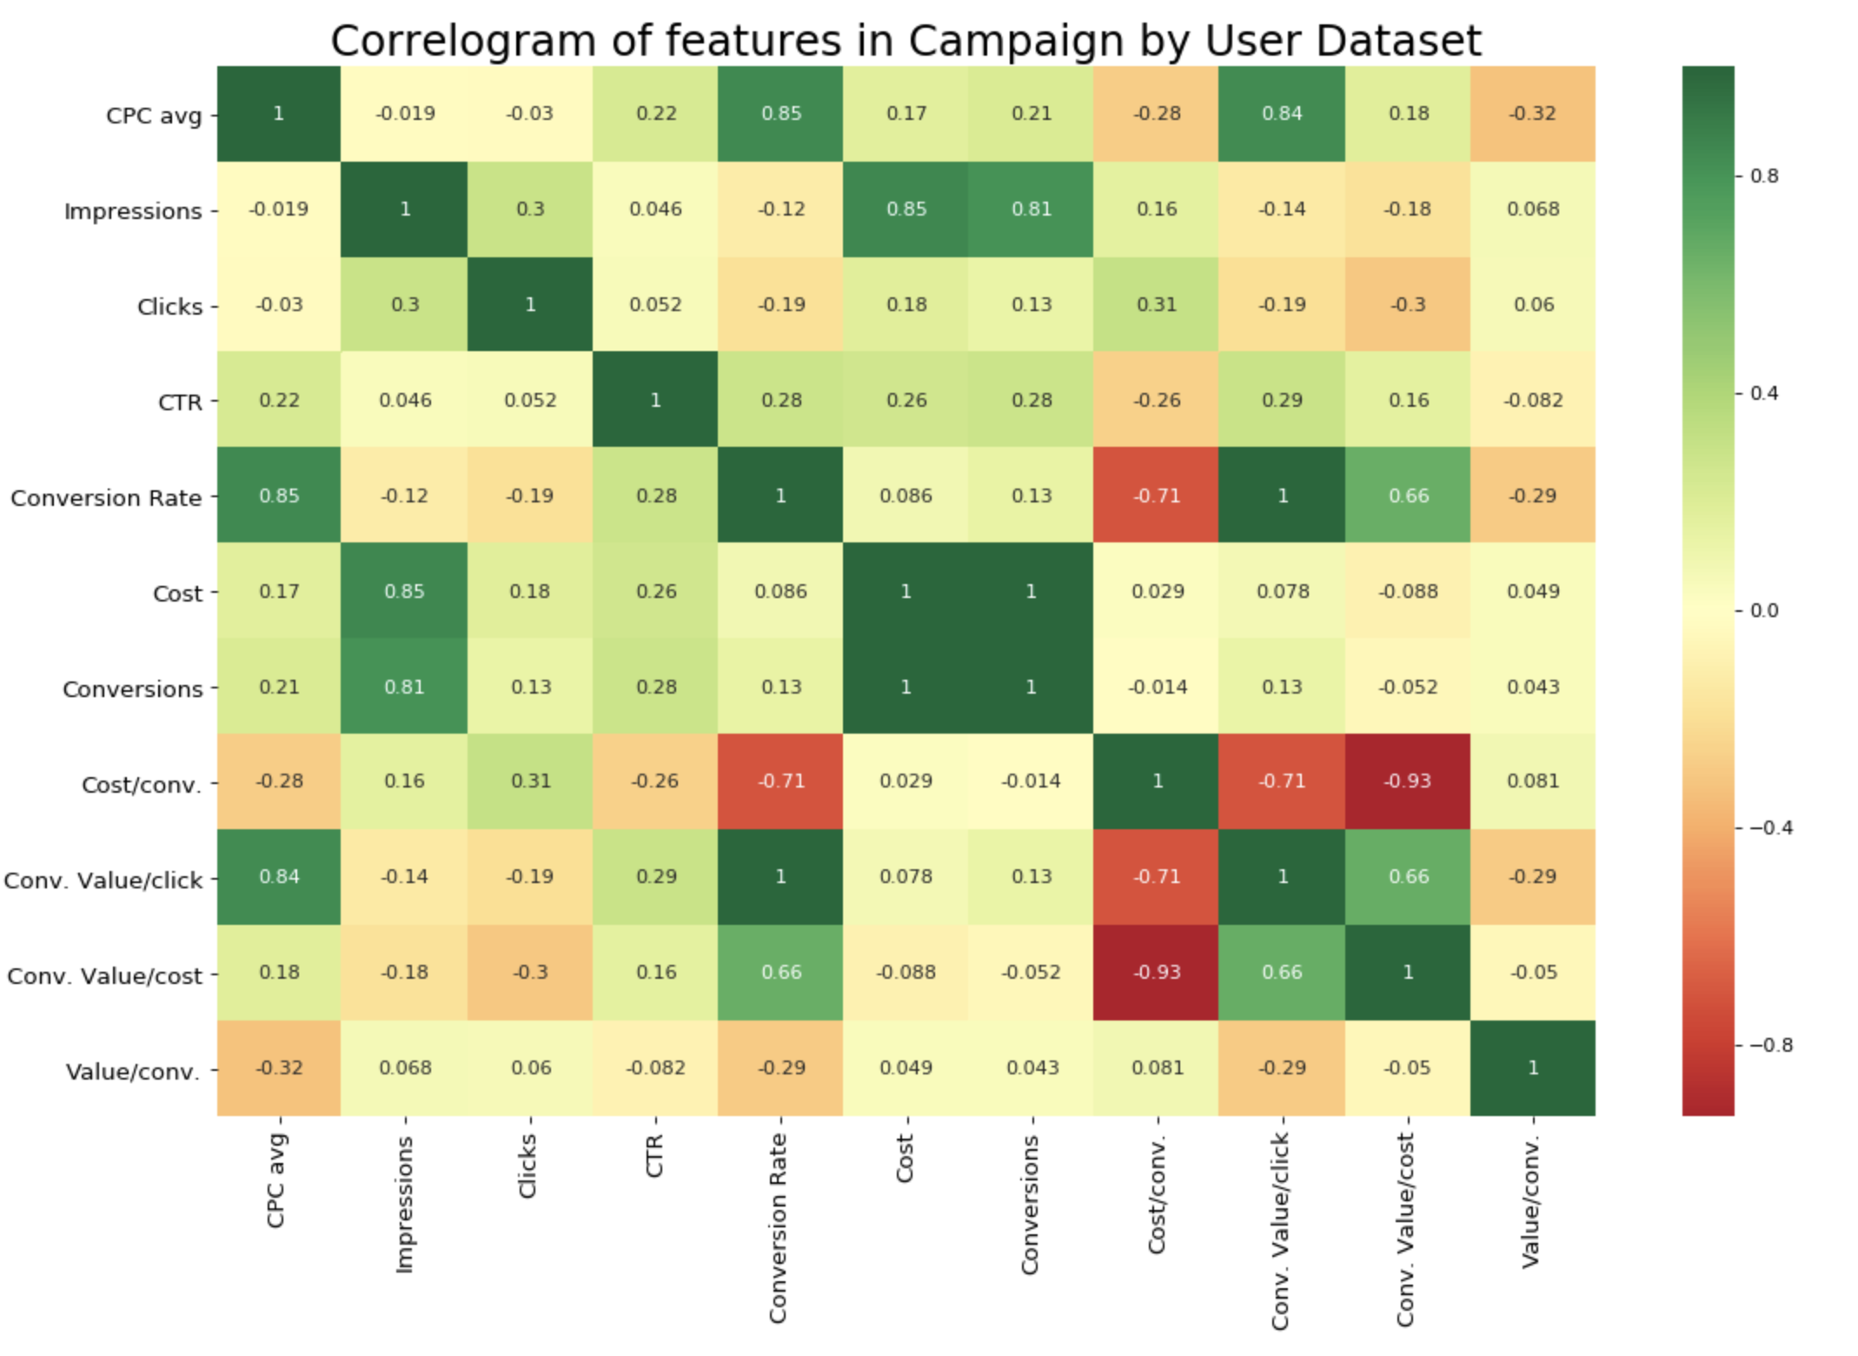
Correlation of User dataset
Getting rid of multicollinearity features and do the One-hot-encoding
among categorical features.

Slide 12
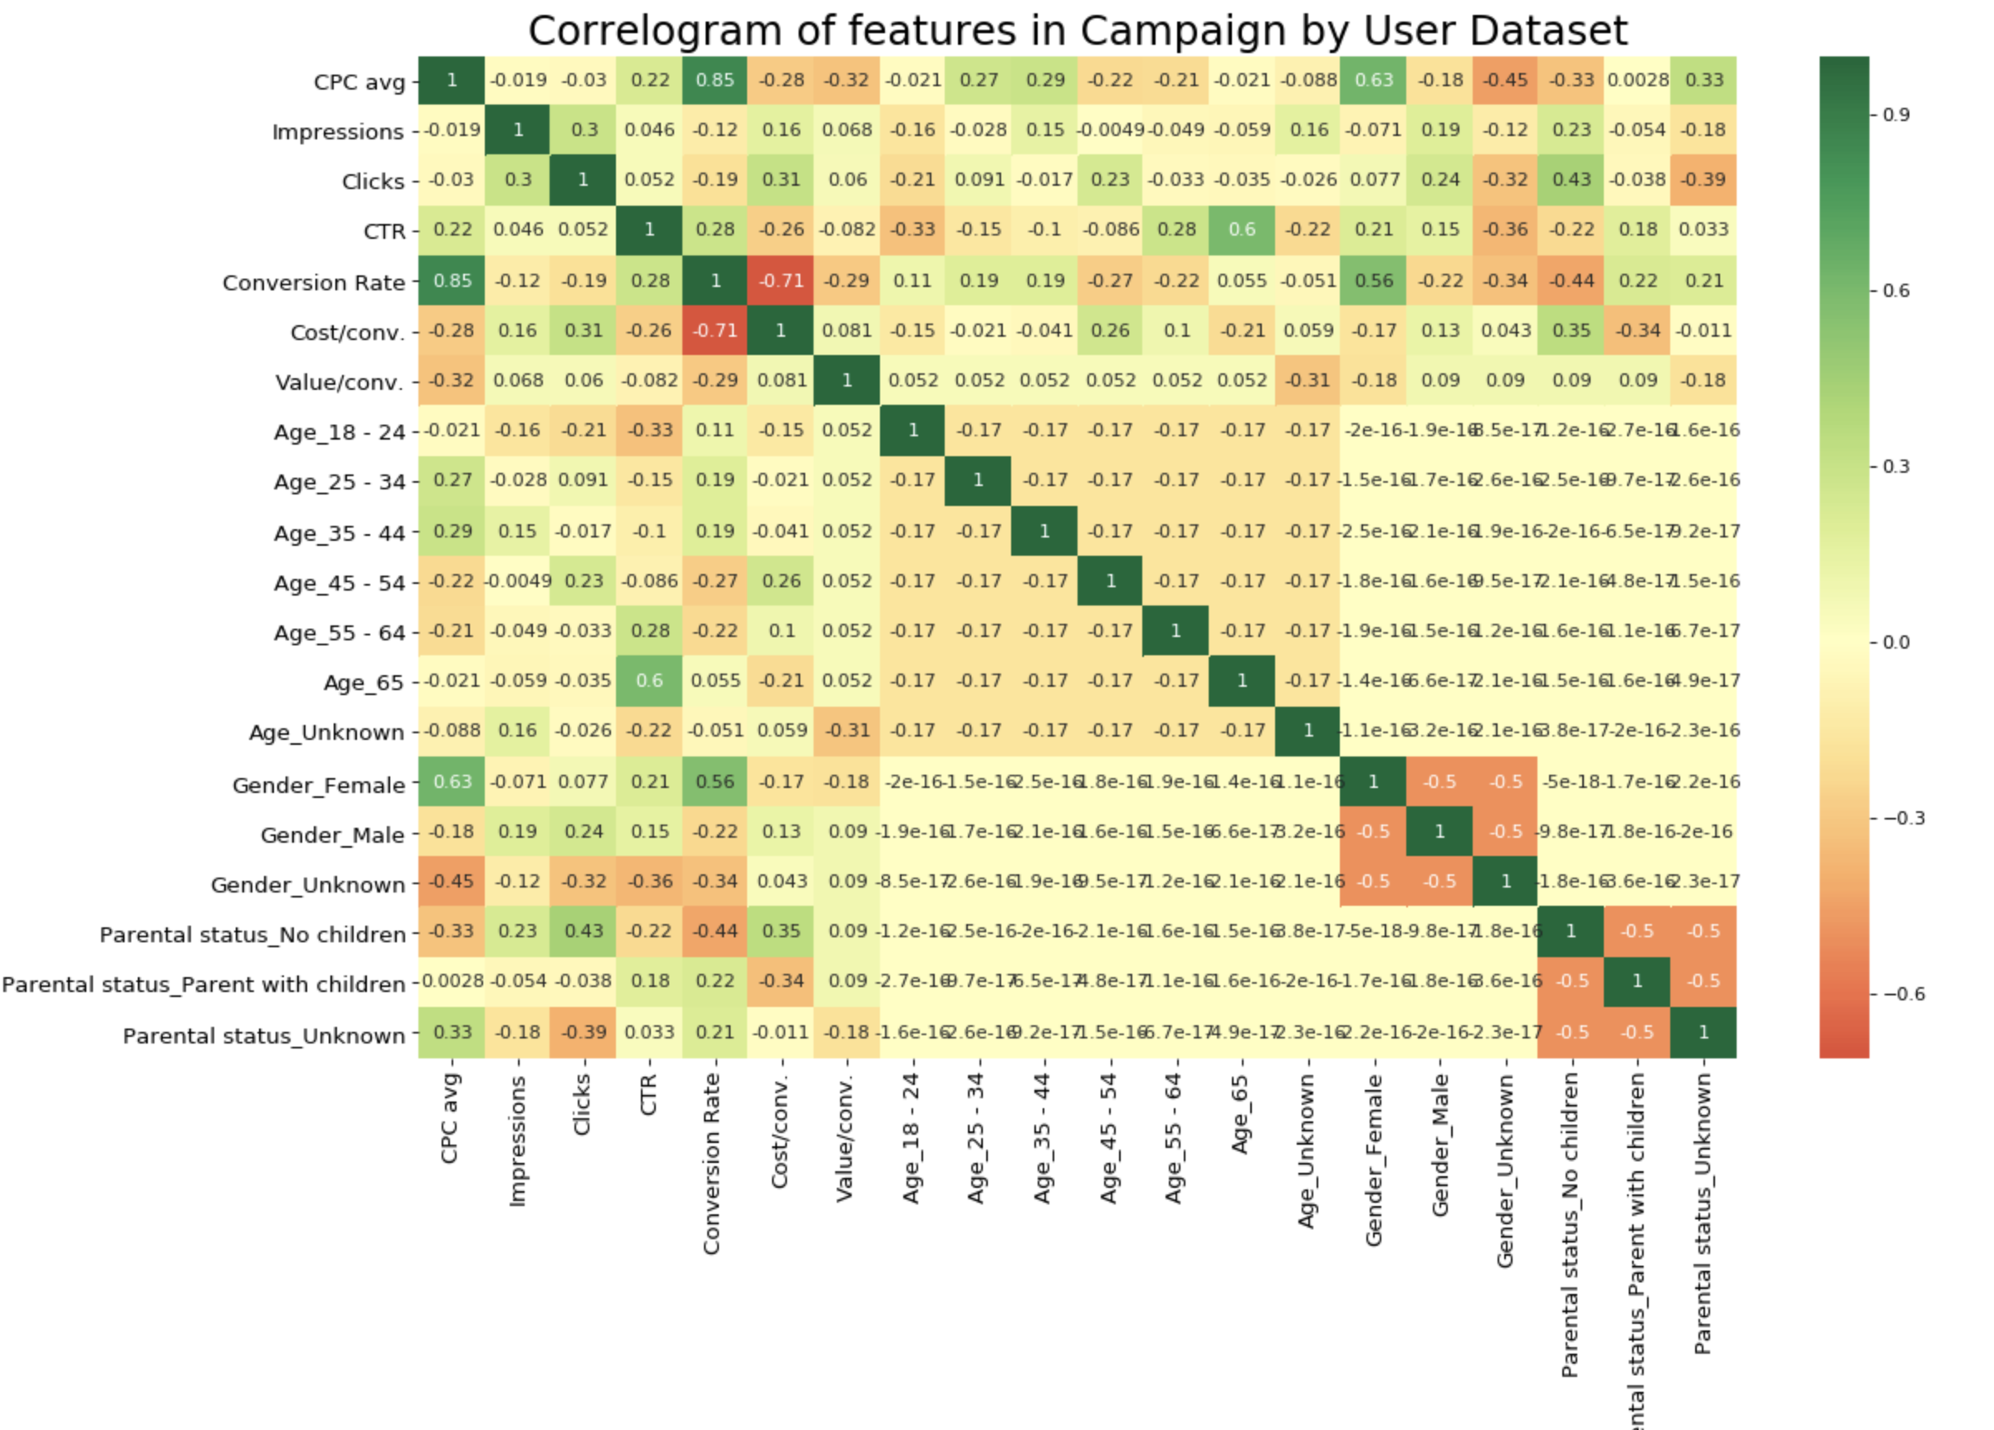
Correlation of User dataset

Slide 13
Classification and Prediction
Having tried in Python using regularized dataset in RF model, the Accuracy is 100%, I think it should be something because of the user dataset is already aggregated.
Bring it into BigML, we only use the demographic features, which is age, gender, parental status to cluster users using conversion rate.

Slide 14
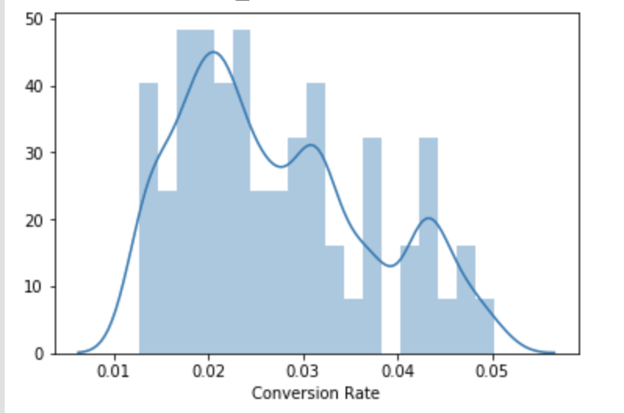
Labeling
Assumption:
Conversion Rate over 0.04 can be labeled as “Highly Convertible”
Conversion Rate between 0.03-0.04 can be labeled as “Convertible”
Conversion Rate between 0.02-0.03 can be labeled as “Shortly Convertible”
Conversion Rate lower than 0.02 can be labeled as “unlikely Convertible”

Slide 15
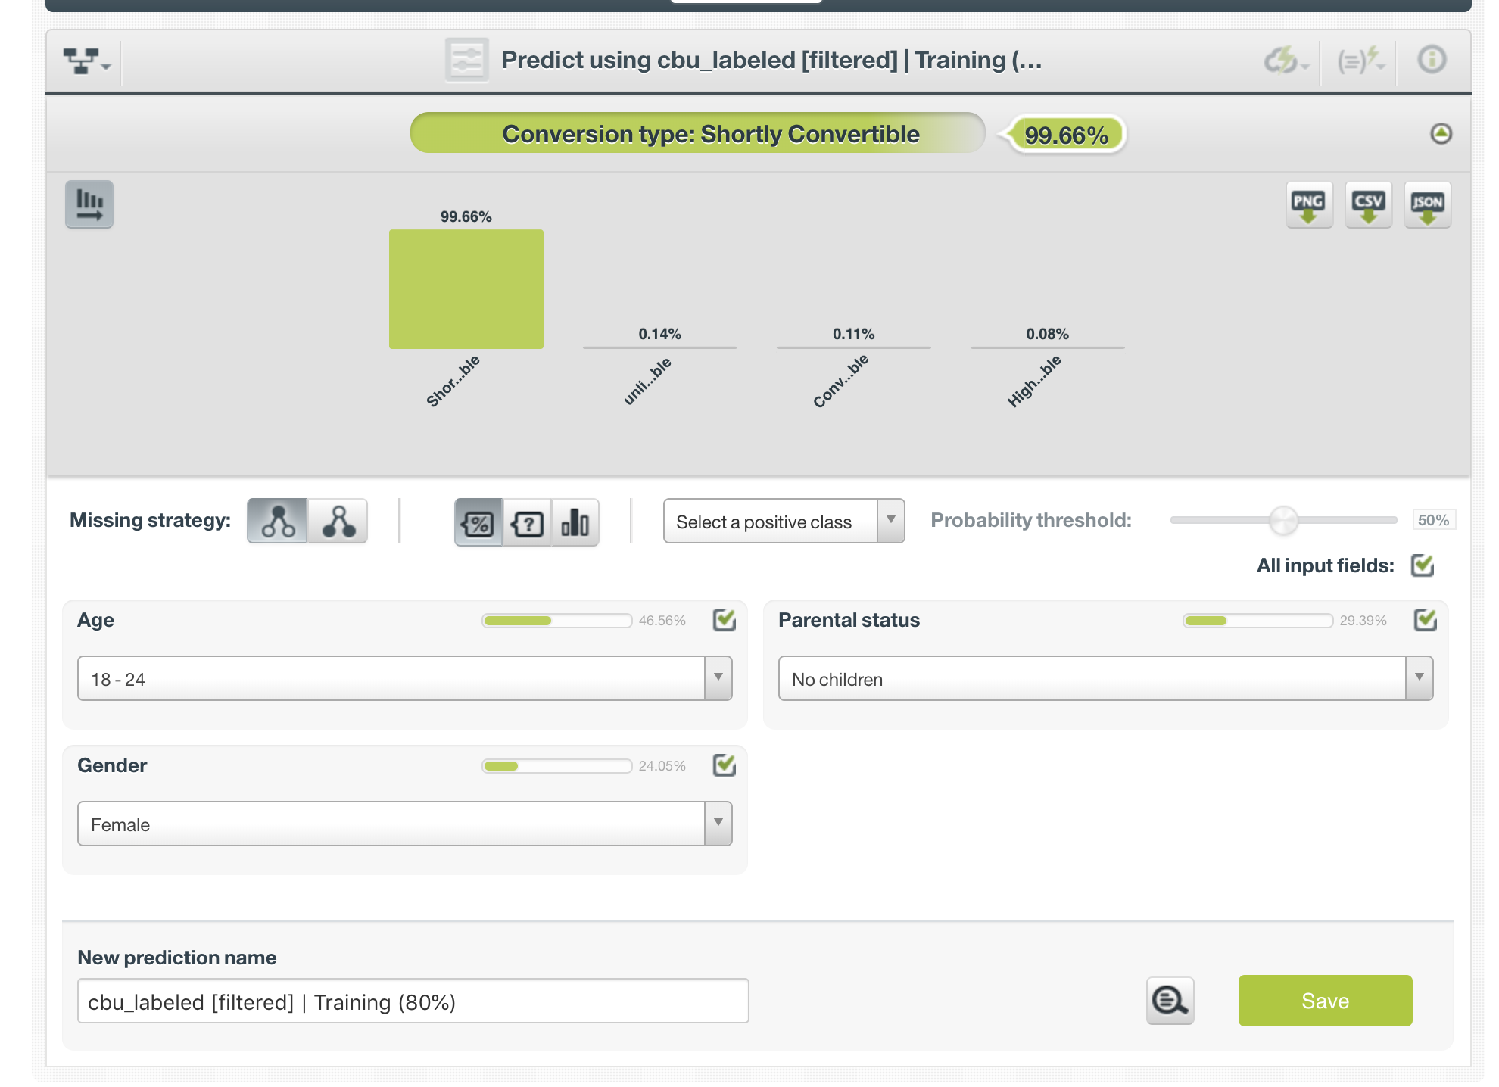
Classification and Prediction

Slide 16

ACTIONABLE DASHBOARDS
Page 3: Campaign Performance by User

Slide 17

ACTIONABLE DASHBOARDS
Page 4: Youtube Campaign Performance

Slide 18
ACTIONABLE MODEL 1
METHODOLOGY, DEMO & FUTURE OUTLOOK

Slide 19
EDA gave us an idea of multicollinearity that exists in the dataset. We have set a threshold of 0.85 as a cutoff baseline for variables that are highly correlated with conversion rates. The following columns were not extracted into our analysis:
Conversions
Value conv./click
Value conv./cost
Cost/conv
Since our assumption is that Mobiground has no data in-regards to any conversions of their ads and that we are trying to help them understand conversions, any conversion calculations will not be included in all of our models.
Goal: To predict conversion rates of a campaign given the hour of the day.

Slide 20
There are two categorical columns in which we need to use one-hot encoding to extract its features: Status and Bid Strategy. One-hot encoding is a basic method where we assign each categorical column a binary value of 0 or 1.
We use a test size of 0.25 as it gives us the most accurate representation of the train/test split. The resulted data-frame has 24 columns and less than 1000 rows for us to play with.

Slide 21
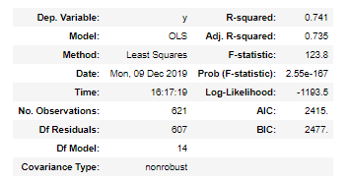
After splitting train/test to 75/25, we created OLS regression model which will be able to tell us about the variance within the training dataset.
R-squared value of 0.741 shows that our model explains 74% of the variance in our dependent variable, which is interpretable.
(OLS stands for Ordinary Least Squares which uses the ‘Least Squares’ method to fit a regression line that would minimize the square distance from the regression line.)

Slide 22
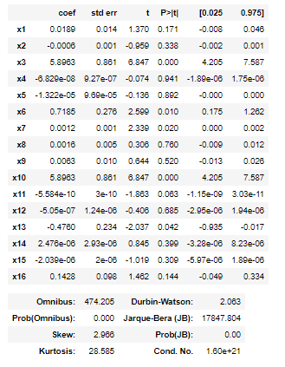
From the model summary, we can see that most of the independent variables are statistically significant in predicting conversion rates.

Slide 23



After running the initial OLS model, we start out by running multiple regression models without any regularization techniques. Since our train dataset only contains more than 600 samples, we want to test out two different regularization techniques (Lasso and Ridge) to see if we can overcome the overfitting.
Apart from regression methods, we move onto ensemble methods: we use a baseline model which will include all features but no extra hyper-parameter tuning techniques. The first baseline model that we ran to predict conversion rate is Random Forest Regressor with 1000 decision trees.
The second model we ran is a Random Forest Regressor with Randomized Hyperparameter Tuning technique called RandomizedSearchCV (package from scikit.model_selection). This technique initiates the different parameters and do cross-validation to figure out the best parameters to use for the given model.

Slide 24
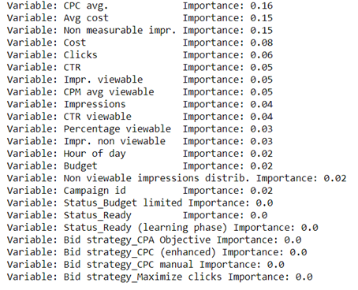
We ran a feature importance extraction of all variables using the Random Forest model
The most important variable predictor to conversion rate is CPC avg(Cost per click) with an importance score of 0.16.
Some other notable important predictors are non-measurable impressions, cost and clicks

Slide 25
Hyper-parameter tuning technique:
RandomizedSearchCV
The RandomizedSearchCV ran against the training dataset, which totals 1000 fits and finished its job in 15 minutes, the resulting parameters that it got out was:
{'n_estimators' (number of trees in forest): 1800,
'min_samples_split' (The minimum number of samples required to split an internal node): 2,
'min_samples_leaf' (The minimum number of samples required to be at a leaf node): 4 ,
'max_features' (The number of features to consider when looking for the best split): 'sqrt' (sqrt(features)),
'max_depth' (The maximum depth of the tree): 90,
'bootstrap' (whether bootstrap samples were used): True}

Slide 26
The last modification that we made to the random forest model is to use GridSearchCV which looks deeper into the parameters that were chosen by the initial RandomizedSearchCV. GridSearchCV adds another functionality to the hyperparameters by letting us cross-validate against the values that we are interested in only.
Again, we use 10-fold cross-validation to search for the best possible parameters within the range that we set. GridSearchCV ran for 2 hours but there was no significant increase in MAE or MAPE scoring and hence we use the random forest model with randomized search CV as our to-go model.

Slide 27
Evaluation Metrics
MAE refers to Mean Absolute Error, which gives less weight to outliers, which is not sensitive to outliers
MAPE refers to Mean Absolute Percentage Error, which is similar to MAE, but normalized by true observation. Downside is when true obs is zero, this metric will be problematic.
MSE refers to Mean Squared Error, which is MSE is like a combination measurement of bias and variance of your prediction
RMSE refers to Root MSE, usually take a root of MSE would bring the unit back to actual unit, easy to interpret your model accuracy.
NRMSE refers to the normalized RMSE numbers which is easier when comparing numbers from different models

Slide 28
Model | Evaluation Metric
 | MAE | MAPE | MSE | RMSE | NRMSE | Accuracy
OLS | 1.032 | 0.333 | 4.249 | 2.061 | 0.896 | 66.72
LR | 1.028 | 0.334 | 4.260 | 2.064 | 0.897 | 66.65
Lasso-R | 1.066 | 0.358 | 4.263 | 2.065 | 0.897 | 64.15
Ridge-R | 1.028 | 0.334 | 4.259 | 2.064 | 0.897 | 66.63
Elastic | 1.066 | 0.358 | 4.263 | 2.065 | 0.897 | 64.15
RF-1000 | 0.949 | 0.293 | 4.705 | 2.169 | 0.942 | 70.68
RF-HT | 0.915 | 0.284 | 4.364 | 2.089 | 0.908 | 70.69

Slide 29

User Demo

Slide 30


FUTURE OUTLOOK
The model works well when there are actual conversions. It can predict campaigns that are doing well given the hour of the day and other features, however it cannot predict the outliers or extravagant campaigns which did not do so well or have returned with a 0% conversion rate.
In the future, it is advised to Mobiground that if possible, we should collect other features in regards to a campaigns performance in order to be able to predict the campaigns that might not do well in terms of conversion. Also the sample size was very small and hence we had to make assumptions.

Slide 31
ACTIONABLE MODEL 2
METHODOLOGY, DEMO & FUTURE OUTLOOK

Slide 32
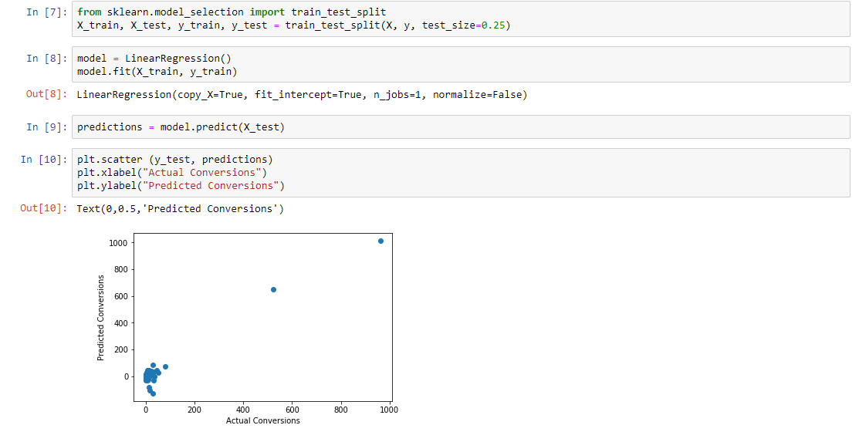

Slide 34
User Demo

Slide 35
Q&A
Any Questions/Answers/Inquiries?

